Slide 1

Center Tank
Port Tank
Strbd Tank

Slide 2
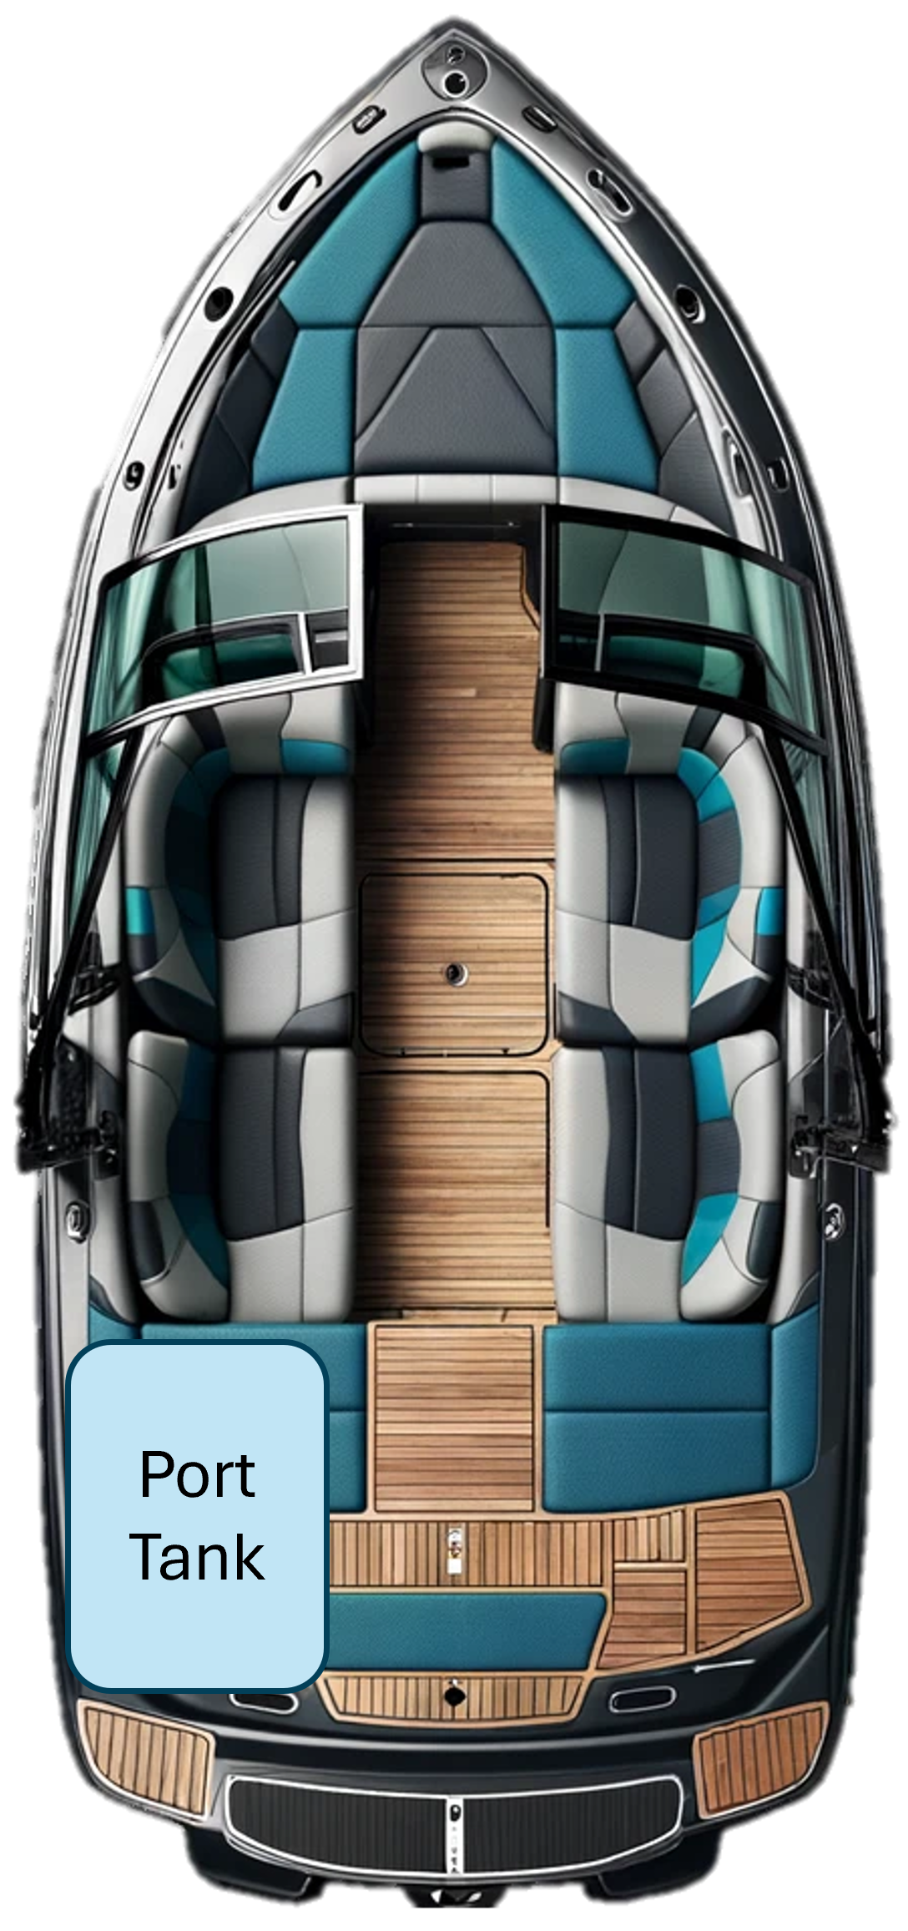

Slide 3
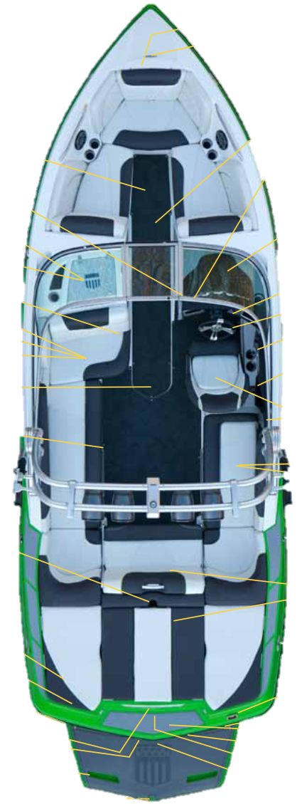
Center Tank
Port Tank
Strbd Tank

Slide 4



